Slide 1
TASK :- 03
Product: Telecommunication software

Slide 2
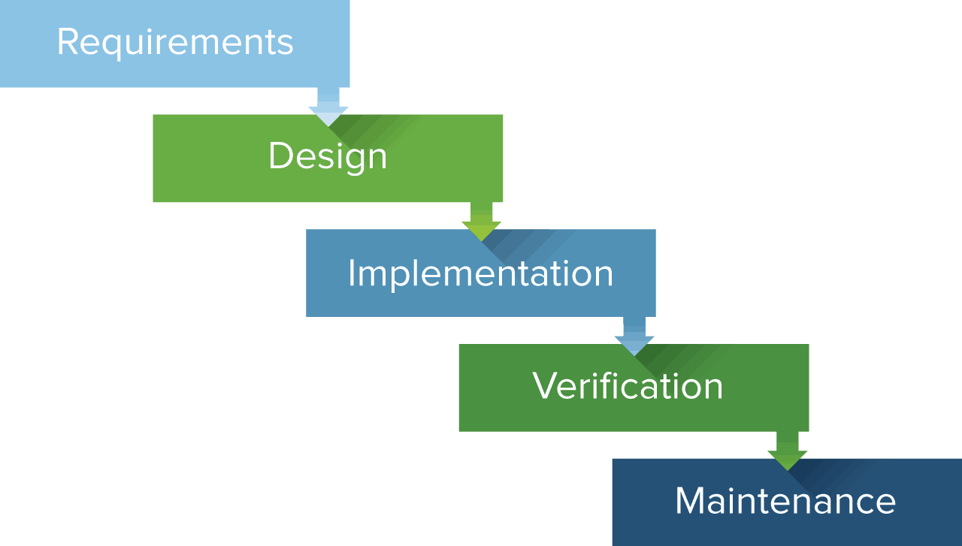
Gather functional andnon-functional requirements specific to telecommunication software.
Specify communication protocols,security layers, and data routing mechanisms.
Develop modules for core telecommunication functionalities.
Perform unit verifing of individualmodules
Monitor performance in real-time and ensure optimal network operation.

